Slide 1
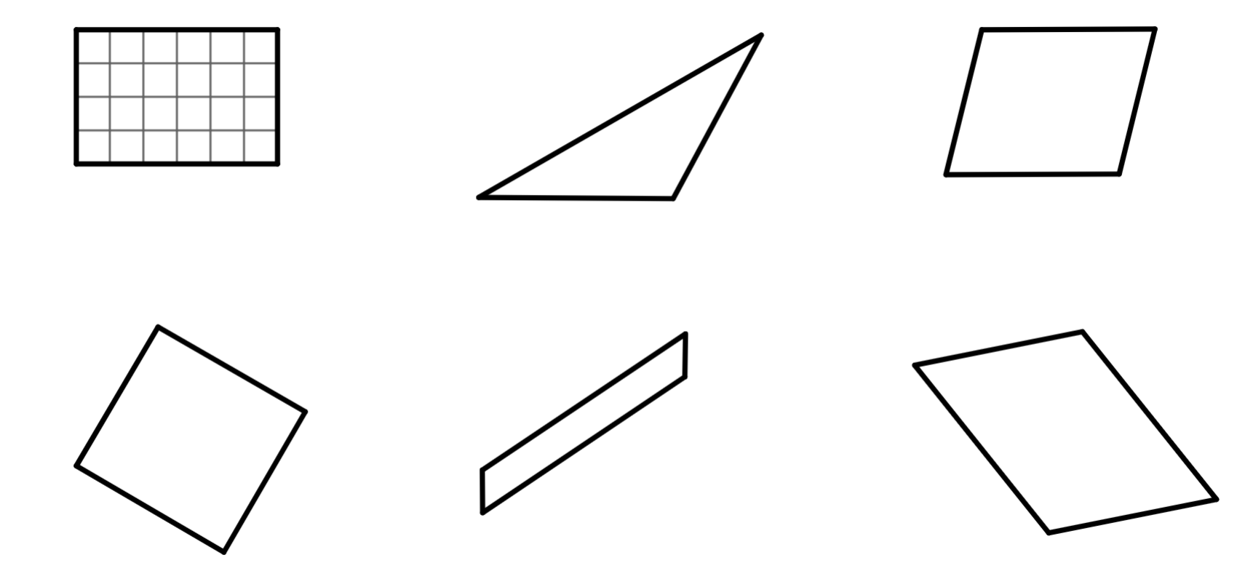
Checking understanding of area
Task A: Areas of rectangles, triangles and parallelograms
Find the area of each shape.
a)
b)
7 cm
4 cm
5 cm
area = units²
area = cm²
c)
d)
8 mm
10 cm
9 cm
8 mm
9 mm
11 cm
area = _
area = _
e)
15 cm
f)
1 cm
7.5 m
12 m
9 m
18 cm
6 m
area = _
area = _

Slide 2
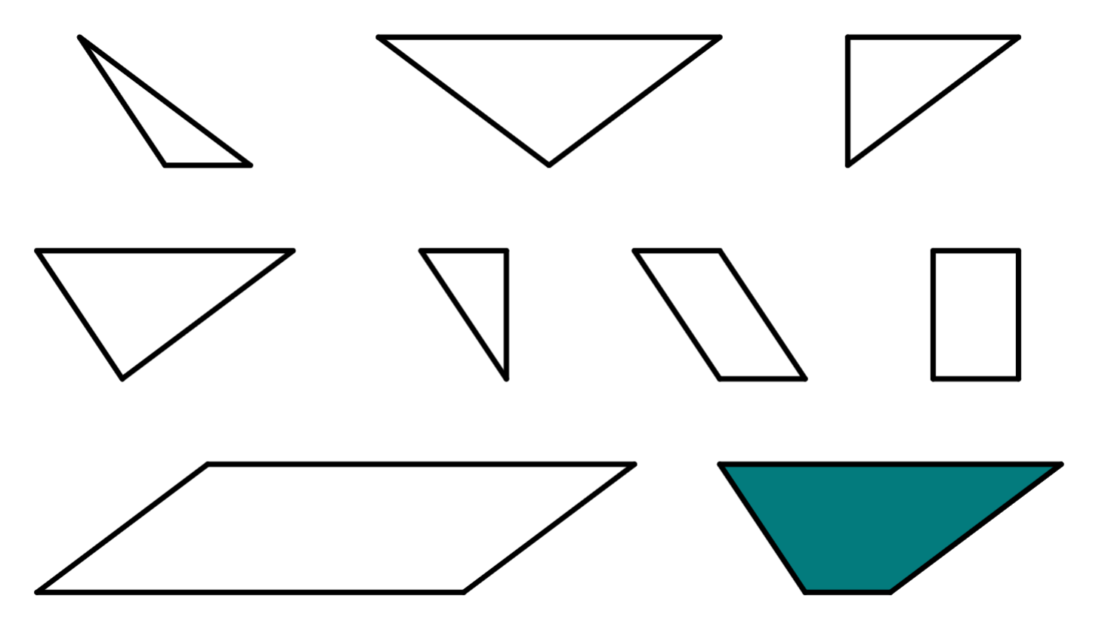
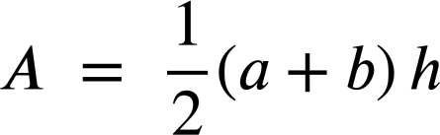
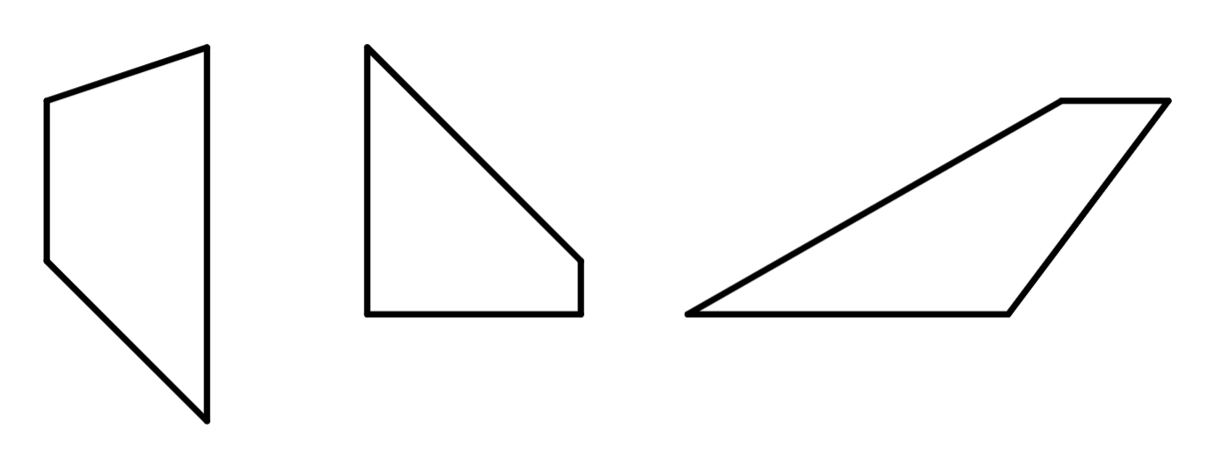
Checking understanding of area
Task B: Areas of trapezia
1) The letters inside each shape represents its area.
a) Use each letter once to fill in the gaps in the calculations. Multiple solutions exist.
2
T = + +
F
T
3
A
3
T = +
8
10
T = +
3
T = ÷ 2
B
3
C
3
D
E
3
2
2
2
2
6
b) Find the value of T.
F
3
G
3
3
H
T = units²
4
8
2) All of the shapes below are trapezia.
Use the formula or any other method to calculate the area of each
trapezium.
For a trapezium with parallel sides a and b:
a)
6 cm
b)
c)
4 cm
4 cm
5 cm
7 cm
3 cm
1 cm
3 cm
2 cm
4 cm
4 cm

Slide 3

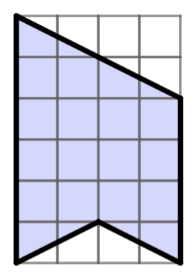
Checking understanding of area
Task C: Areas of composite shapes
1) Find the area of each composite shape.
a)
b)
2 mm
4 mm
7 cm
5 mm
3 mm
4 cm
8 mm
5 cm
c)
1 cm
1 cm
Mathematics in Education and Industry
v2.3

